Slide 1
MAGFest 2024 Soldering Workshop
Arsenio Menendez
Emily Anthony

Slide 2
Agenda
Classroom (30m)
Soldering Terminology
How to Solder
What are we building today?
Safety Brief
Lab (60m)
The PCB
Resistors
Capacitors
LEDS
CH32 MCU
Diode Array

Slide 3
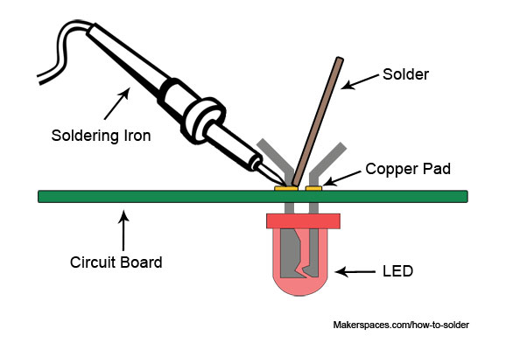
Soldering Terminology and Tools
“Soldering iron” is a hot iron with a pen end to meld solder around electrical connections
“Solder” is a metal alloy that is melted to create a bond between electrical parts
“Flux” is a wax or synthetic material that is used to improve mechanical properties and bond of the solder to electrical contacts

Slide 4
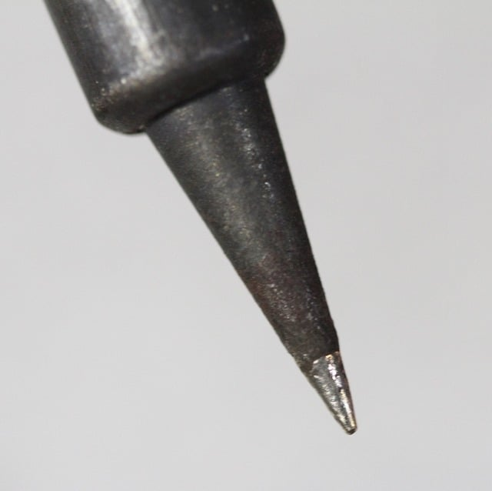
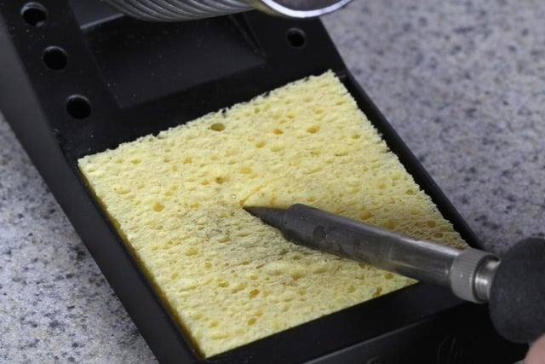
Soldering Terminology and Tools
Solder tips are cleaned when hot by rolling them over a wet sponge
“Tin the tip” is a process to cover a newly cleaned iron tip with a small layer of solder
It is recommended to clean and tin the tip of your iron a couple of times during this workshop

Slide 5
Soldering Terminology and Tools
Solder Sucker
Flux Paste
Wick Braid
ESD Tweezers
Helping Hand

Slide 6
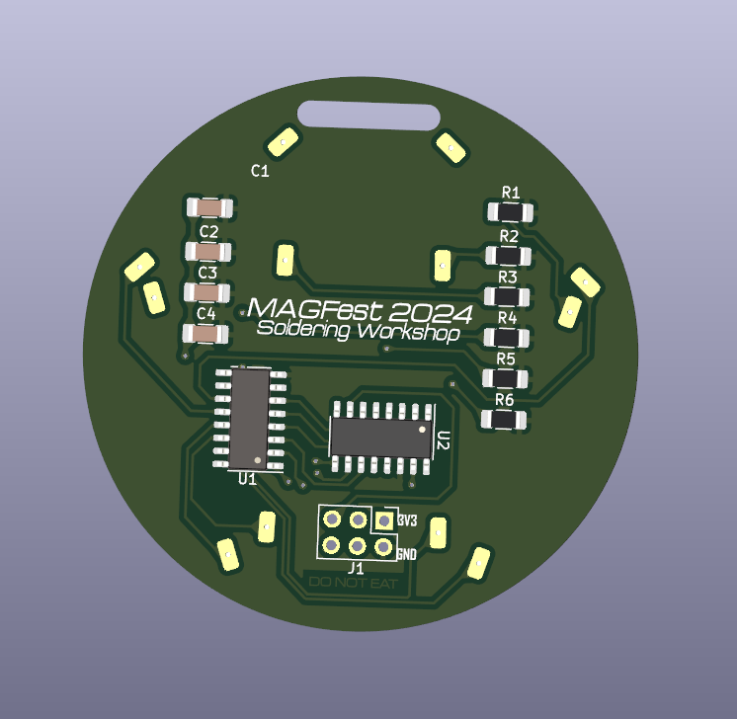
Board Terminology
“PCB” or a “Printed Circuit Board” is a multi-layer board made of fiberglass, resin, and copper (mostly)
“Component” is any item attached to the board
“Copper Pad” is the exposed area on a board that is ready for soldering
“Reference Designator” is the shorthand note on the board for the component
“Thru Hole” is a component that has holes through the board for mounting
“Surface Mount” is a component that mounts on one side of the board only

Slide 7
How to Solder: summary of steps
Turn on Soldering Iron and get it up to temperature
Clean soldering tip on a wet sponge
“Tin” the tip
(the above steps have been done for you)
Place Component on board in the correct orientation
Heat the joint with the tip
Apply solder while tip is at joint
Remove Solder Wire
Remove Tip and Inspect

Slide 8
Step 1: place the component in the correct location and orientation
Component orientation and positioning is critical. For each component on the board, we will tell you how to place it
On some components, such as our capacitors and resistors, orientation doesn’t matter
Some components, like our Diodes and MCU, have a dot to indicate orientation
Every component has an alphanumeric Reference Designator to tell you where to put it

Slide 9
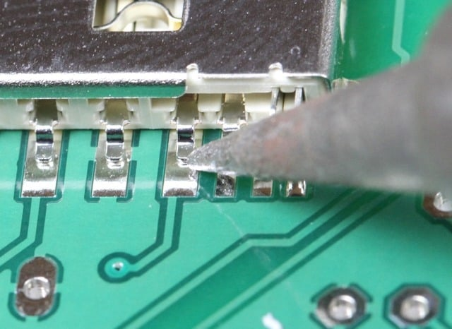
Step 2: Heat the Joint with the Tip
Place the hot iron on the pad to preheat it
Make sure the iron is touching the pad on the PCB and not the component. This is to make sure there is enough heat in the solder pad and to avoid damaging the component

Slide 10
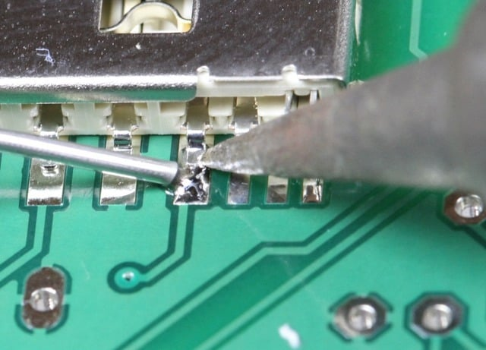
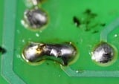
Step 3: Apply solder to the joint
Solder looks like wire, and melts quickly. Place the tip of the solder on the pad and press gently
Too much solder can lead to bridging of adjacent pads
Too little solder may not provide sufficient connection

Slide 11
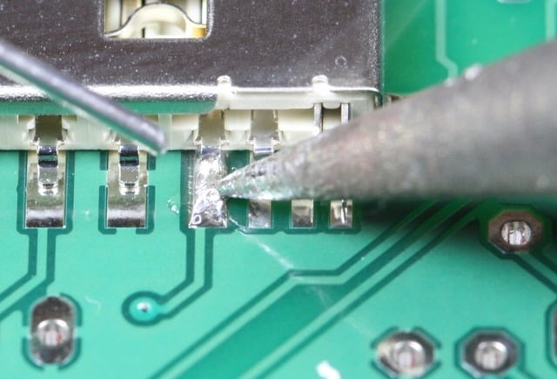
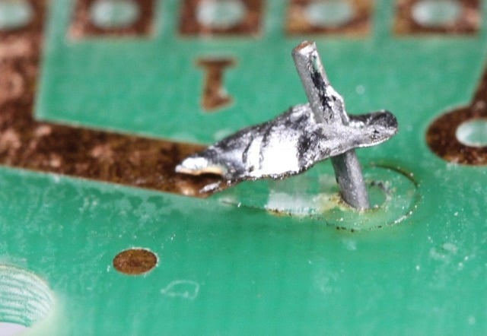
Step 4: Remove the solder wire
Do not remove the iron first
If you remove the iron first, you risk cooling the solder wire to the pad and ripping it when you pull it away

Slide 12
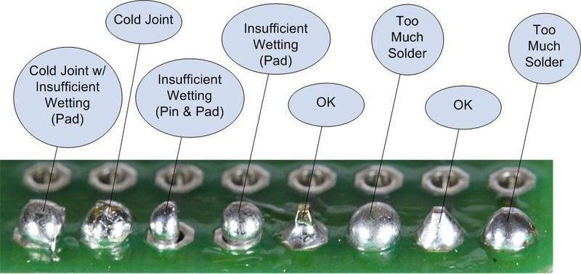
Step 5: Remove the tip and inspect

Slide 13
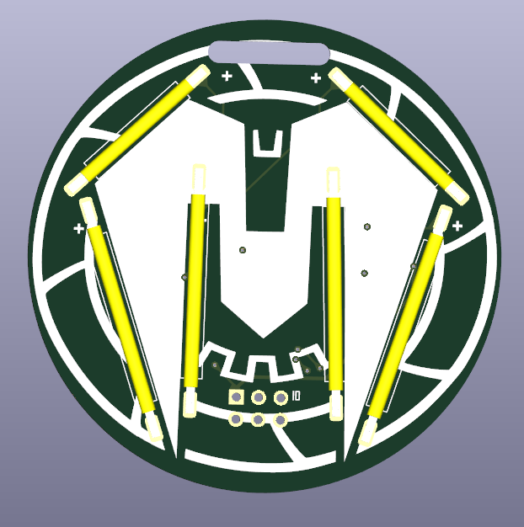
Okay… so what are we building?
This is a custom designed PCB for this lab that can connect to your Swadge and blinks
It has 6 LEDS (the yellow bars shown) and a CH32 microcontroller (MCU) that can receive commands from the Swadge
We will assemble the PCB in steps together, going from least to most difficult components
Note: This can work without a swadge and we have a test bench for you to verify your pcb works

Slide 14
Safety Brief
Soldering irons are hot. Do not touch your skin or others with them, or place them on a work table. They may only be in your hands or in the holder.
The Solder we are using has Lead in it. Lead is hazardous to your health when ingested. Wash your hands after soldering and DO NOT EAT while participating in this workshop. You may wear nitrile gloves.
It is recommended to wear protective eyewear.
It is recommended to wear a mask.
Note the location of a fire extinguisher nearby, AED, and emergency exits.

Slide 15
Any questions before we get started?

Slide 16
Order of Assembly
BOTTOM
C1 and C4
C2 and C3
Resistors
TOP
Short LEDs
Long LEDs
BOTTOM
U1 Diode Array
U2 CH32
TOP
J1 Connector

Slide 17
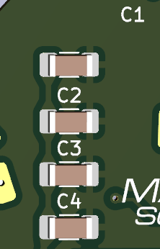
Capacitors C1 and C4
Side: Bottom
Orientation: doesn’t matter
Reference Designators C1 or C4
Value = 1 uF
Place Component on board
Heat the joint with the tip
One joint at a time, start on the left
Apply solder while tip is at joint
Remove Solder Wire
Remove Tip and Inspect

Slide 18
Capacitors C2 and C3
Side: Bottom
Orientation: doesn’t matter
Reference Designators C2 or C3
Value = 0.1 uF
Place Component on board
Heat the joint with the tip
One joint at a time, start on the left
Apply solder while tip is at joint
Remove Solder Wire
Remove Tip and Inspect

Slide 19
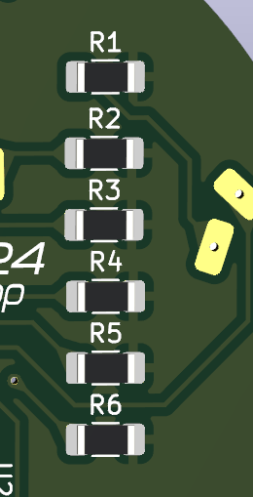
Resistors
Side: Bottom
Orientation: doesn’t matter
Reference Designators R1 – R6
Place 1 Component on board
Heat the joint with the tip
One joint at a time, start on the left
Apply solder while tip is at joint
Remove Solder Wire
Remove Tip and Inspect

Slide 20
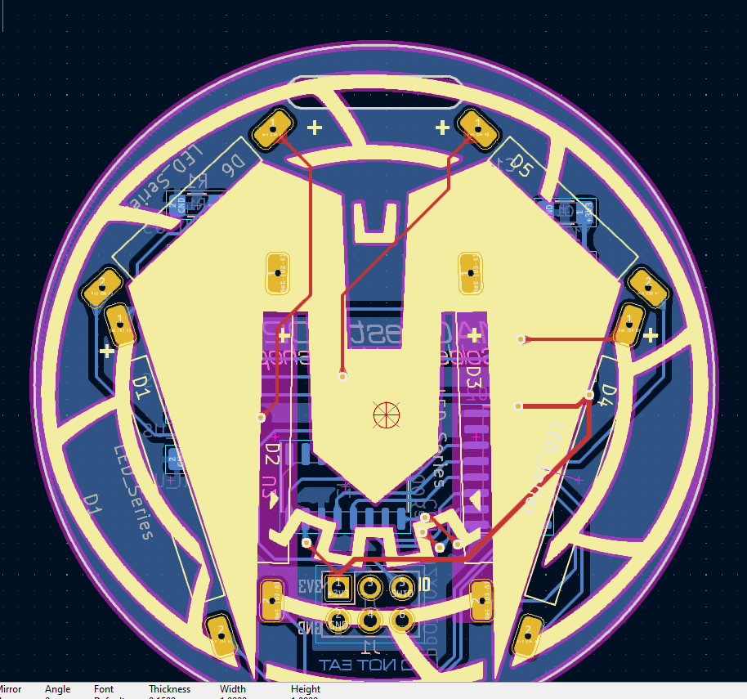
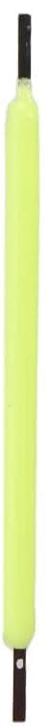
Short LEDS
Side: Top
Orientation: Matters! There is a dot/hole on the bottom side
Reference Designators D2, D3, D5 and D6
Value = 20.5mm long
Place Component on board
Heat the joint with the tip
One joint at a time, start on the top
Apply solder while tip is at joint
Remove Solder Wire
Remove Tip and Inspect

Slide 21
Long LEDS
Side: Top
Orientation: Matters! There is a dot/hole on the bottom side
Reference Designators D1 and D4
Value = 28mm long
Place Component on board
Heat the joint with the tip
One joint at a time, start on the top
Apply solder while tip is at joint
Remove Solder Wire
Remove Tip and Inspect

Slide 22
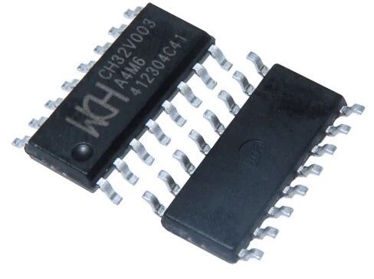
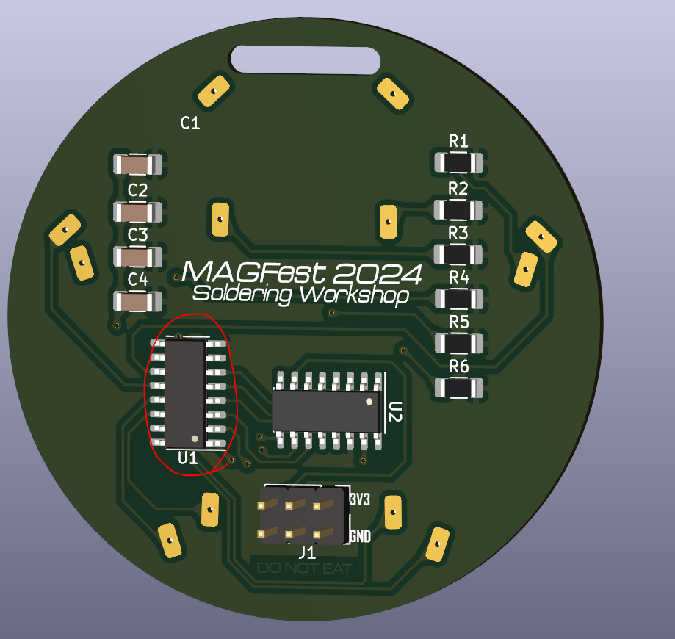
U1 MCU
Side: Bottom
Orientation: Matters! Pay attention to the dot and place it in the orientation shown
Reference Designator U1
Value = CH32V003
Place Component on board
Heat the joint with the tip
One joint at a time, start on the top
Apply solder while tip is at joint
Remove Solder Wire
Remove Tip and Inspect

Slide 23
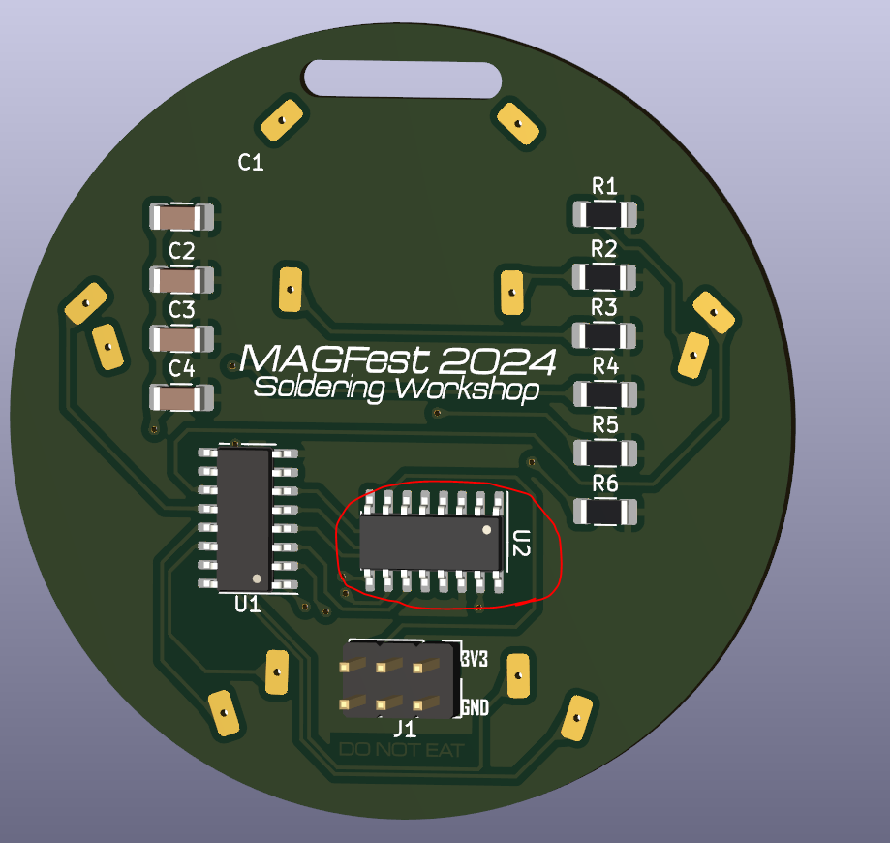
U2 Diode Array
Side: Bottom
Orientation: Matters! Pay attention to the dot and place it in the orientation shown
Reference Designator U2
Value = ULN2002
Place Component on board
Heat the joint with the tip
One joint at a time, start on the top
Apply solder while tip is at joint
Remove Solder Wire
Remove Tip and Inspect

Slide 24
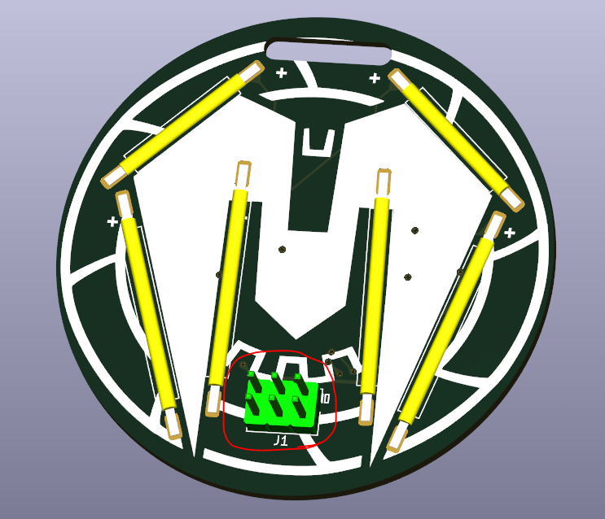
J1 Connector
Side: pins on top, solder on bottom
Orientation: doesn’t matter
Reference Designator J1
Place Component on board
Heat the joint with the tip
Recommend doing one corner, then the opposite
Apply solder while tip is at joint
Remove Solder Wire
Remove Tip and Inspect

